Slide 1


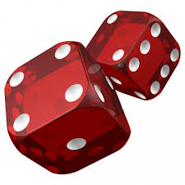

Activities that
Engage Students in
Research Methods
Role
Play
William Trochim
Workshop presentation:
Thirty-Sixth Annual National Institute
On the Teaching of Psychology
The TradeWinds Island Grand
St. Petersburg Beach, Florida
January 3, 2015
Simulation
Thinking

Slide 2
Active Learning
As opposed to what?
  Passive Learning?
  Active non-learning?
  Passive non-learning?
The role of “engagement”
  Does “engagement” always involve “activity”?
    Engaging lectures and unengaging activities
Four examples of active learning
  Engagement activities or “teachable tidbits”
  Role playing
  Data analysis simulations
  Validity thinking scenarios

Slide 3

Activity 1
Engagement Activity or “Teachable Tidbit”

Slide 4
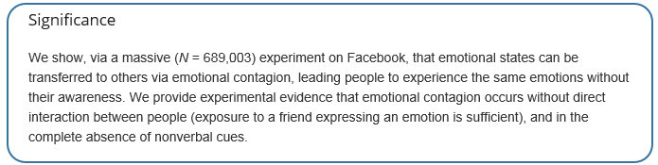

Facebook and “Emotional Contagion”
Kramer, A.D.I., Guillory, J.E., & Hancock, J.T. 2014. Experimental evidence of massive-scale emotional contagion through social networks. PNAS, 111, 8788-8790.
Available at: http://www.pnas.org/content/111/24/8788.full

Slide 5
Facebook and “Emotional Contagion”
The Essentials:
  Over a one-week period in 2012, researchers manipulated the news feeds for a random sample of close to 700,000 Facebook users.
  News Feed is the constantly updating list of content from your friends that is shown on the middle of your Facebook page.
  Because there are typically more stories than can be displayed, Facebook uses an algorithm that tries to show the stories a user would find most engaging or relevant.
  One group had reduced negative content; one reduced positive
  Used the Linguistic Inquiry and Word Count software (LIWC2007) to determine emotionality of content

Slide 6
Facebook and “Emotional Contagion”
The Essentials (cont.):
  The hypothesis was that subsequent user posts to Facebook would be affected by what they saw in the News Feed
    People in the positivity-reduced group would have less positive posts
    People in the negativity-reduced group would have less negative posts
  The results supported the hypothesis that people’s emotions may be affected by what their friends say (social contagion)

Slide 7
Facebook and “Emotional Contagion”
The Controversy
  Facebook users were not asked whether they wanted to participate in this study
  It was assumed that the Facebook Data Use Policy, to which every user agrees, had informed users that their data might be used for such research purposes:
    Among other things, Facebook uses information “for internal operations, including troubleshooting, data analysis, testing, research and service improvement.” (https://www.facebook.com/full_data_use_policy)

Slide 8
Facebook and “Emotional Contagion”
Assignment
Pair up
Discuss (5 minutes) the following questions with your partner
What ethical issues are raised by this study? (brainstorm and prioritize)
Could Facebook have addressed the hypothesis without explicitly manipulating the content of the News Feed?

Slide 9
Facebook and “Emotional Contagion”
Discussion and Presentation
  Ethical issues
    Informed consent; three elements
      Information – were participants provided sufficient information?
      Comprehension – did participants fully understand the study and have an opportunity to ask questions?
      Voluntariness – if the above two have been met, are participants free to decline or withdraw?
    Vulnerable populations
      Include: children, prisoners, people with impaired cognitive capacity
  Design Issues
    Randomized experimental design and manipulation versus
    Observational/Correlational designs and “big data” analyses

Slide 10
Resources for Engagement Activities
Wrap-Up and Resources
  The Research Methods Knowledge Base
    http://www.socialresearchmethods.net/kb/
  The “Summer Institute” story
    The Summer Institute for the Teaching of Biology
      Jo Handelsman & colleagues
      Began at University of Wisconsin
      Moved to Yale (and multiple institute sites)
      Became the Yale Center for Scientific Teaching (http://cst.yale.edu/)
      The “teachable tidbits” lingo (http://cst.yale.edu/teachable-tidbit-general-categories). Website includes:
        Forms for standardizing
        Reviewed teachable tidbits
        Topical tidbits in a wide variety of areas of biology

Slide 11

Resources for Engagement Activities
    Active Learning
      Ciaccia, L., Tsang, T. and Handelsman, J. Summary of Key Papers on Efficacy of Active Learning, accessed from
      http://cst.yale.edu/sites/default/files/active%20learning%20bibliography.pdf)
        Comprehensive annotated bibliography that includes
          Meta-analyses
          Experimental Psychology Studies
          Discipline classroom based studies (controlled classroom studies)
          Reports (not controlled)
          Reviews
      Handelsman, J., Miller, S.M., & Pfund, C. 2006. Scientific Teaching. W. H. Freeman, New York.

Slide 12
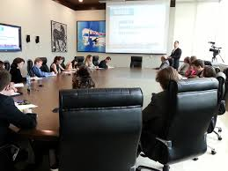
Activity 2
Role Play Simulations

Slide 13
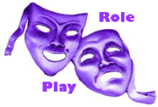
Activity Setup
Project: A study of the comparative efficacy of two prevalent forms of treatment, inpatient and outpatient, for persons with dependence on cocaine.
Setting: A grant was given by the National Institute on Drug Abuse to researchers at Metropolitan University to study cocaine treatment options in the NortheastNet Hospital System.

Slide 14
Activity Setup
Teams (The “Cast”)
  Program Team
    Program Director (PD)
    Medical Director (MD)
    Grants Officer (GO)
    Hospital Administrator (HA)
    Patient Advocate (PA)
  Research Team
    Coordinating Consultant (CC)
    Design Consultant 1 (DC1)
    Design Consultant 2 (DC2)
    Measurement Consultant (MC)
    Statistical Consultant (SC)

Slide 15
Activity Setup
Scripts. Prior to each session each player receives three scripts:
  Overview Script (all roles)
  Team script (one each for Project and Research Team)
  Individual script
Process. The project will play out in four “sessions” or meetings of both teams that span the five years of project time. Of course, both teams (and likely subteams) will need to have separate meetings (planning, debriefing) between project meetings to get work done.
Reporting. After each meeting, three concise reports required:
  Questions – mainly about simulation rules/procedures
  Minutes – a list of key discussion points from both teams
  Assignments – for each member of each team

Slide 16

Activity Setup
Need 10 volunteers
  5 on Program Team
  5 on Research Team
Because of time constraints we will use a “Fishbowl” technique to illustrate briefly how a meeting proceeds
Notes:
I present and assign the roles, give program and research team instructions to everyone and then have volunteers exit for a few minutes to review their confidential goals – during this time I will also tell the larger group about some of the confidential instructions given
Then the teams will be brought back and the first meeting will begin

Slide 18
Volunteers exit - Confidential Scripts
Program Team
  PD: MD should be your “devil’s advocate”
  MD: advocate for a “rigorous” randomized experimental design (even though you know it’s not likely feasible)
  GO: Works for NIDA. Wants quality research. Don’t want anything too new or crazy
  HA: You can’t let research affect the “bottom line” for the hospital. May have trouble convincing the 10 hospitals to participate.
  PA: You’re the “outsider” on this team. Your job is to make sure patients’ rights are protected. Most important, patients should have the right to choose their treatment! You should say this at some point during the first meeting.

Slide 19
Volunteers exit - Confidential Scripts
Research Team
  CC: Concentrate on getting the facts out. And, on keeping your team from bickering (especially quantitative versus qualitative arguments)
  DC1: You’re a quasi-experimentalist and don’t think randomized experiment is appropriate for this study.
  DC2: You emphasize validity in research. You’re an ally to the CC. In first meeting, you can be calm. If people get in any argument, you say that whatever methods are ultimately chosen should be based on validity concerns.
  MC: You know about sampling and measurement. At first meeting just get the facts.
  SC: As a statistician you might add that the randomized experiment is more straightforward and easy to analyse than quasi-experimental alternatives (although you might like the challenge)

Slide 20
Activity Setup
Session 1 begins with the first joint meeting of both teams in the conference room of the primary site of the project in a NortheastNet hospital. The Program Director calls the meeting to order……

Slide 21
Scripted Role Playing
Purpose: to engage students in a structured and controllable simulation of a “real life” research project consultation.
Process
  Determine
    Project, context, setting
    Structure (teams, events)
    Overall “storyline”
    Roles
    Critical elements (e.g., concepts to emphasize)
  Develop scripts for different levels of the system (project, team, individual)

Slide 22
Scripted Role Playing - Advantages
Scripted role play allows instructor to
  Introduce critical elements into the project
  Introduce drama – and fun (e.g., personalities)
  Control the flow of events
  Control the length of the project
Over a “practicum” or “internship”
  Is far more manageable
  Can control the topics covered (flow)
  Requires less coordination
  Is re-usable
  Is a “shared” experience across the team/class
It’s a fun way to learn (and teach)

Slide 23
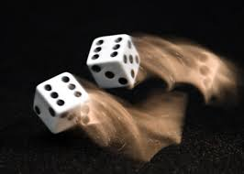
Activity 3
Dice Rolling Simulations

Slide 24

Dice Rolling Simulations - Background
Based on “true score” theory
  An observed score is the sum of a “true” value and some random error
  The formula: X = T + e
  We can use dice to generate (simulate) both values
  Roll a pair of dice once for true score, once for error and then add together
Creating a “pretest” and “posttest”
  We will assume that nothing changes between the pretest and posttest (a “reliability” situation)
  We will use the same true score for both measures, but separate error scores for each

Slide 25
Activity Setup
Divide into small teams. Each team has a pair of dice
Using the handout labeled Table 1-1, fill in the 50 rows of columns 2-4 with the results
Manually add up the columns
  The Pretest: X = True + Error(x)
    Column 5 = Column 2 + Column 3
  The Posttest: Y = True + Error(y)
    Column 6 = Column 2 + Column 4
Graph the frequency distribution for
  Pretest in Figure 1-1
  Posttest in Figure 1-2
Graph the bivariate (x,y) distribution in Figure 1-3

Slide 26
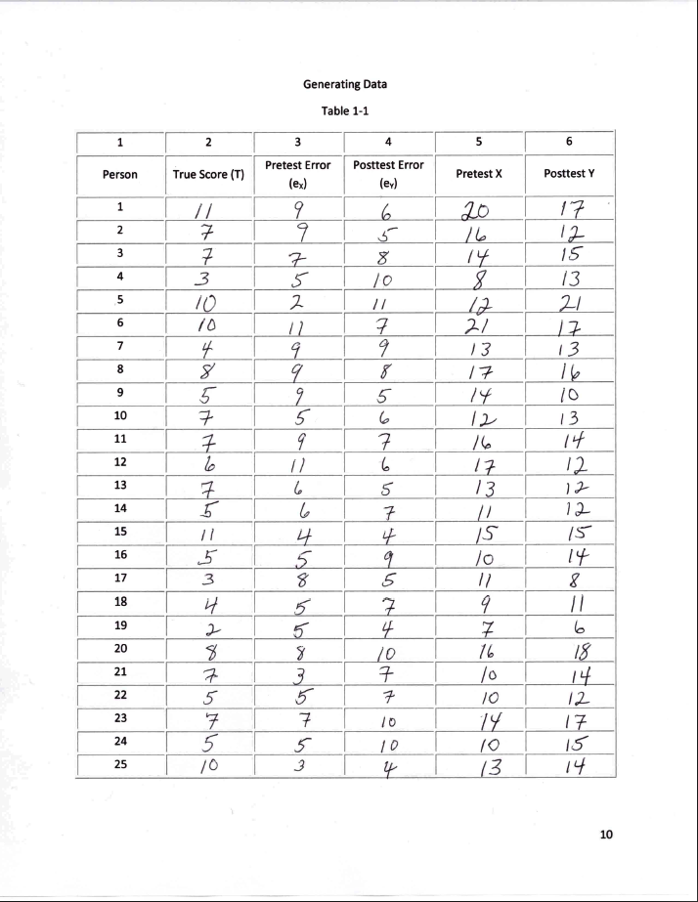
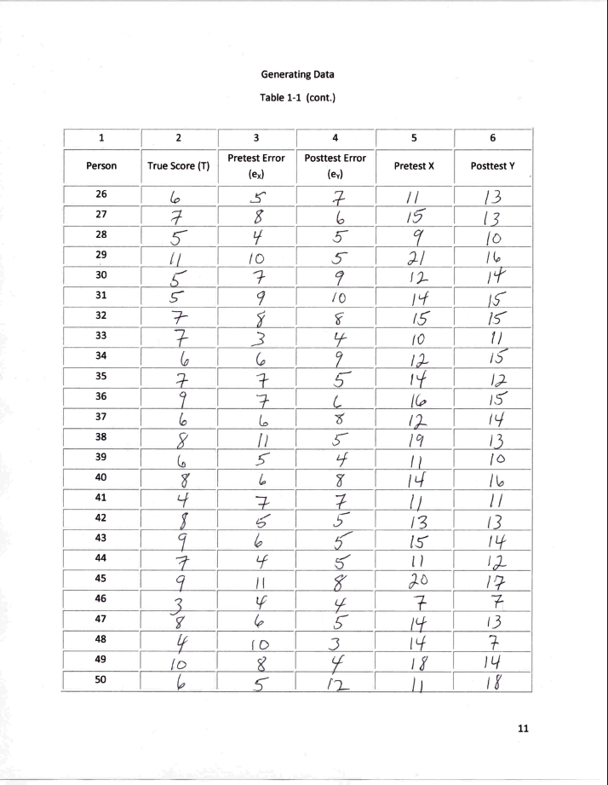
Example Data Recording Table

Slide 27
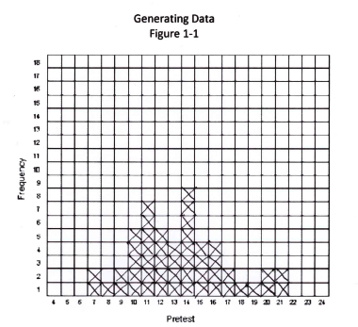
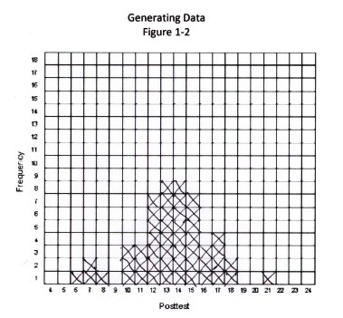
Example Frequency Distributions

Slide 28
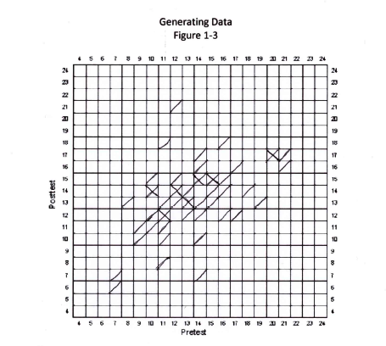
Example Bivariate Plot

Slide 29
Fit a Line through the Data
Use Figure 1-3
  Begin with the leftmost column
  For each column try to estimate its vertical center point
    If there are no marks in the column, skip and move to the next rightmost column
    If there is only one mark in a column, place a dot in that cell
    If there are multiple lines in a column, either
      Place a dot halfway between the lowest and highest marked cell in the column
      Place a dot where the average of all marks in the column is (you can estimate this visually)
  Beginning with the dot farthest to the left, connect the dots in adjacent columns with a line

Slide 30
Example Bivariate Plot with Fitted Lines

Slide 31
Reflection on Dice Rolling Activity
What have you done
  Part I: created imaginary pretest and posttest for 50 people
  Part II: created a “relationship line that showed that the pretest and posttest are “positively” related
    That is, as you go up on one variable you tend to go up on the other as well)
Convince yourself of the following
  If you did this for thousands of people the pretest and posttest distributions would look nearly identical, with more cases in the middle and fewer on the tails, and would have similar numbers on each side of the center (compare your graph with others)

Slide 32
Reflection on Dice Rolling Activity (cont)
You used a simple version of the “true score” model
The pretest and posttest are related to each other because they share the same true score (but not error score!)
The reliability of a measure is the proportion of truth to the total score (true score variance to total variance). Because you used a pair of dice to create each component of each score, you had reliability approximately equal to .5.
  To get higher reliability use more true score and less error
  To get lower reliability use less true score and more error
The line you “fit” is a very rough approximation of a regression line
  If you had thousands of cases you should be convinced that this line would be straight with a slope of about .5

Slide 33
Dice Rolling Simulations
Disadvantages
  Takes time; monotonous
  Dice rolling yields binomial data, not normally distributed (see http://hyperphysics.phy-astr.gsu.edu/hbase/math/dice.html)
  Consequently, results are not exactly what would be expected with normally distributed variables (or analysis like regression analysis, that assume normal distributions)
Advantages
  Very “tactile” and hands-on
  A good approach for non-quantitative students
  A good way to start teaching advanced statistical concepts
  A good gateway to statistical simulation

Slide 34
Simulations
A full simulation manual is available at http://www.socialresearchmethods.net/simul/simul.htm
Complete set of dice rolling and computer (Minitab) simulations for:
  Generating data
  The randomized experimental design
  The Nonequivalent Group Design
  The Regression Discontinuity Design
  Regression Artifacts (or “regression to the mean”)
Invitation - some other possible directions
  Excel
  SPSS
  SAS
  R

Slide 35

Activity 4
Validity Thinking Scenarios

Slide 36

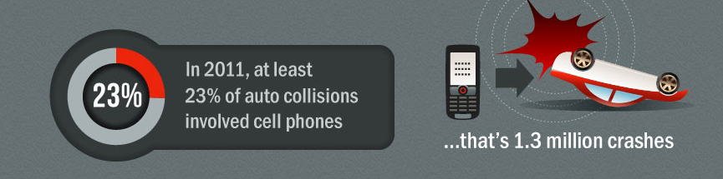
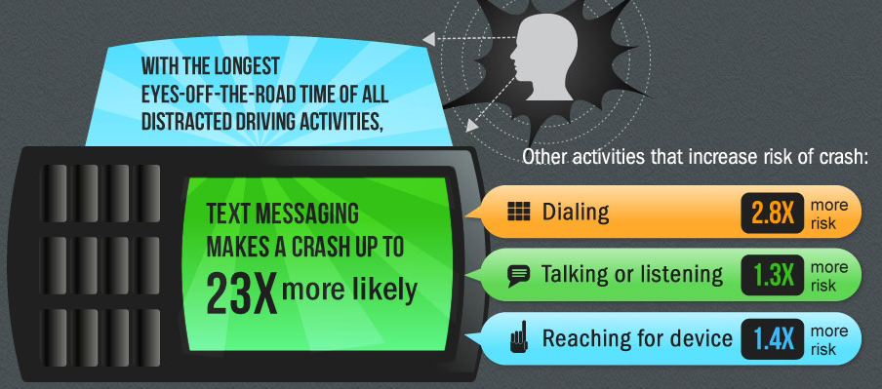
Activity Setup
Texting while Driving

Slide 37

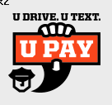

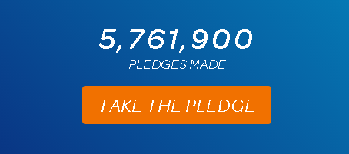
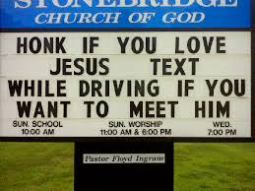

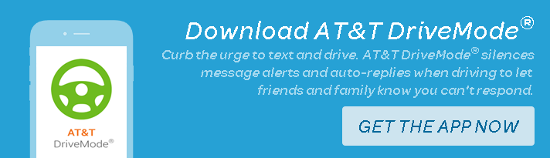
Activity Setup (cont)
Laws
Interventions Include…
Public Awareness
Pledge Campaigns
Education – humor
(sometimes morbid)
Technology

Slide 38
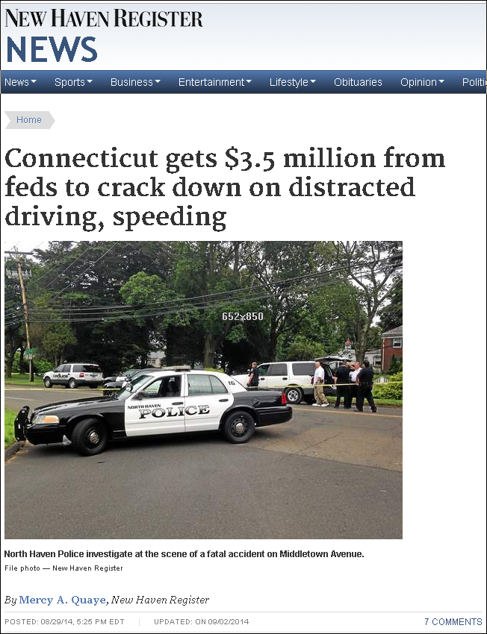
Imagine a Study…
“U Drive. U Text. U Pay.”
The state received $2.3 million in federal distracted-driving-prevention funds from the National Highway Traffic Safety Administration (NHTSA).
North Haven Police received a grant for $10,125, Orange Police received $11,100, Branford received $11,325, and Derby also received a grant to carry out this enforcement mobilization. to carry out this enforcement mobilization.
These funds, and similar disbursements to other towns, will go toward overtime staffing, according to Aaron Swanson, distracted driving program manager for the DOT.
The DOT will also purchase advertising to inform the public of the enforcement campaign.

Slide 39
Imagine the Results…
30
What would you conclude?
How could you be wrong?
25
20
15
CT
10
5
0
Jun-14
Jul-14
Aug-14
Sep-14
Oct-14
Nov-14

Slide 40
Imagine the Results…2
30
What would you conclude?
How could you be wrong?
25
20
15
CT
10
5
0
Jun-14
Jul-14
Aug-14
Sep-14
Oct-14
Nov-14

Slide 41
Imagine the Results…3
30
What would you conclude?
How could you be wrong?
25
20
CT
15
NY
10
MA
5
0
Jun-14
Jul-14
Aug-14
Sep-14
Oct-14
Nov-14

Slide 42
Validity Thinking
Based on Campbell’s Validity Theory
  Campbell, D.T. & Stanley, J.C., 1963. Experimental and Quasi-Experimental Designs for Research on Teaching, in: Gage, N.L. (Ed.), Handbook of Research on Teaching, Publishing, Chicago.
  Cook, T.D. & Campbell, D.T. 1979. Quasi-Experimentation: Design and Analysis for Field Settings. Houghton Mifflin Company, Boston.
  Shadish, W.R., Cook, T.D., & Campbell, D.T. 2002. Experimental and Quasi-Experimental Designs for Generalized Causal Research. Houghton Mifflin Company, Boston.
  Campbell, D.T. and Ross, L.H. (1968). The Connecticut Crackdown on Speeding: Time-Series Data in Quasi-Experimental Analysis. Law & Society Review, 3, 1, 33-54.

Slide 43
Validity Thinking (cont)
Based on Evolutionary Epistemology
  Popper, K., 1985. Evolutionary Epistemology, in: Miller, D.M. (Ed.), Popper selections, Publishing, Princeton, NJ, pp. 78-86.
  Campbell, D.T., 1974. Evolutionary Epistemology, in: Schilpp, P.A. (Ed.), The Philosophy of Karl Popper, Publishing, LaSalle, IL.
Knowledge evolves according to the rules of natural selection
  “blind” variation and selective retention (BVSR)
Ideas survive that have the greatest “fitness” to their environment
Validity refers to the degree to which an assertion you make (e.g., your hypothesis) can survive against alternative explanations

Slide 44
Validity Thinking (cont)
Campbell’s formulation of validity
  In any study there are many
  assumptions/assertions
  For each assertion, there may be many reasons you are wrong
    These are called “threats” to the validity of the assertion
  You establish greater validity in your research when you “rule out” or minimize the more plausible “threats” to validity or plausible alternative explanations to your assertions

Slide 45
Validity Thinking (cont)
Summary
  Present realistic and engaging problem or issue
  Focus on a specific type of assertion related to a validity
  Present one scenario and ask
    What would you conclude?
    How could you be wrong?
  Then present feedback that might change the conclusions or alternative explanations
  Do for several iterations
We need a library of examples for all validity types

Slide 46
Using Active Learning in Teaching Research Methods

Slide 47
Conclusions
Have shown four ways to use active learning
  Engagement Activities
  Role Play Simulations
  Dice Rolling Simulations
  Validity Thinking Scenarios
The importance of context
  Knowing when to use and when not to use
  Level of student ability
  Time available (part of a class to a semester)
An invitation
  Help develop resources for each of these four types of active learning approaches to research methods

Slide 48
Web-Based Resources
http://www.socialresearchmethods.net/Presentations/NITOP2015.htm
  A complete set of resources for this workshop, including
    Presentation (Powerpoint)
    Handout (Microsoft Word)
    Abstract (Microsoft Word)
    Research Methods Role Play Manual (Microsoft Word)
      A complete semester-long role play of a research study of the effects of the the comparative efficacy of two prevalent forms of treatment, inpatient and outpatient, for persons with dependence on cocaine
    Simulations for Research Design (Microsoft Word)
      A comprehensive manual of both dice rolling and computer-based (Minitab) simulations that address five major topics in research methods
        Data Generation (using true score theory)
        The ranomized experimental design
        The nonequivalent groups design
        The regression-discontinuity design
        Regression artifacts (regression to the mean)

